Slide 1







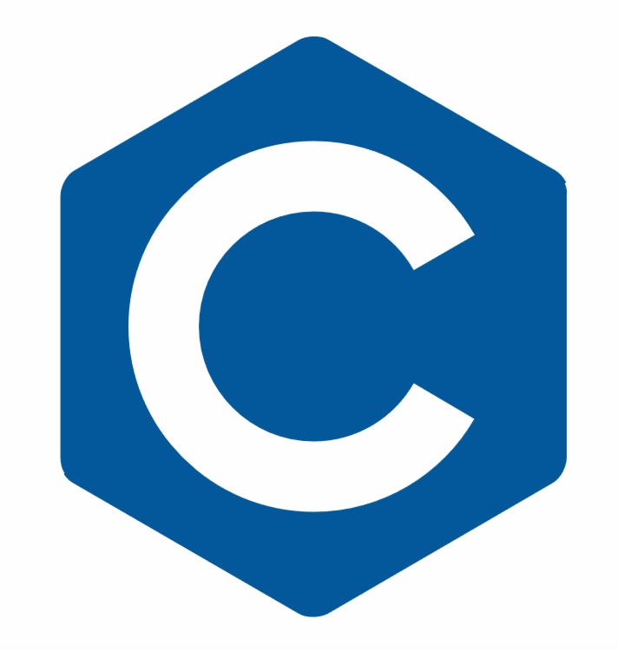



Pursuit Avionics Software & HIL CoDR
Alex Necakov, Asbel Fontanez, Esther Ye,
Rahul Arasikere, Ryuichi Ohhata and Charles Zhou

Slide 2
Software

Slide 3

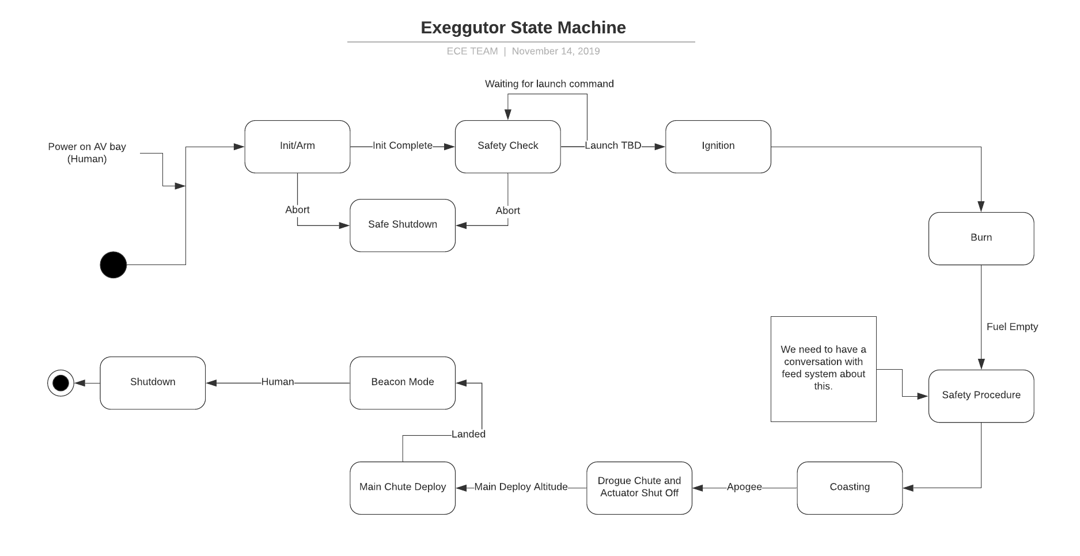
State Machine

Slide 4


Drivers
Adafruit Sensors
Will use adafruit drivers
Sparkfun Sensors
Will use sparkfun drivers
Thermo-Couples
Will need to create custom drivers

Slide 5
Architecture
Initial goal is to develop and test a successful single master - multi slave I2C controller.
Multi-master to slave architecture is also being considered (Industry standard)

Slide 6
Multi-Master to Slave
 | Unit 1 (Data) | Unit 2 (Control) |  | Unit 3 (Voting)
Data Management | Receive Data from Unit 2 | Receive Data from Unit 1 |  | Wait for SOL Alert
 | Save Data to SD | Save Data to SD |  | Check relevant SOL
 | Send Data to telemetry module | Collect Controls Feedback |  | If either Unit dead, shut it down and transfer control
Data Collection | Collect PT data | Calculate Controls Response | Calculations | Do nothing
 | Collect TC data | Send Controls Response |  | **Pink only implemented for 3-comp system
 | Collect Altimeter data | Collect Prop. Control Feedback
 | Collect IMU data | Calculate Prop. Control Response
 | Collect Battery Data | Send Prop. Control Response
 | Collect GPS data | Check Recovery Deployment Data (deploy chute if needed)
 | Check Unit 2 SOL, if DEAD alert Unit 3 | Check Unit 1 SOL, if DEAD, alert Unit 3
 | Send Data to Unit 2 | Send Data to Unit 1
Wait | Wait for Unit 2 to Complete | Wait for Unit 1 to Complete

Slide 7
Altitude (for space)
Normal pressure sensors will not work.
Kalman filter with IMU+altimeter.
This will be used till the altitude the altimeter is rated to, after which we will integrate based on the IMU sensor.
GPS is not capable enough to accurately provide altitude data.
Sensors selection was covered in the hardware CoDR.

Slide 8
Sign of Life (SOL) (only for 3-comp system)
Purpose: Redundancy.
SOL shows that the microcontrollers are working properly. If they aren’t, we can transfer the tasks of the malfunctioning microcontroller to the one that’s working
Set Up: Two microcontrollers w/ different tasks. Each will send SOL signal and receive the other’s SOL.
Each will connect to the same sensors through the shared bus and be able to access the other’s sensors if needed.
Protocol: When the SOL signal is not received for a certain amount of time --exact amount TBD--, the receiver will assume the sender is down and take on additional tasks in its place.
If there are conflicting reports, a third computer will make an executive decision.

Slide 9
Possibilities Chart
Case | Reported Status | Action
M1: Working M2: Working | M1: Working M2: Working *no conflict* | No adjustment needed
M1: Not Working M2: Working | M1: Not Working M2: Working *no conflict* | Switch tasks to working microcontroller
M1: Not Working M2: Working | M1: Working M2: Working *conflict* | Voting System
M1: Not Working M2: Not Working | M1: Not Working M2: Not Working *oh no* | Let’s hope this doesn’t happen
Note:
The third computer will only act as a tie-breaker, if it malfunctions but if there is no conflict between Yin & Yang, it will be fine.
It will only be a problem if the tie-breaker malfunctions and there is conflict.

Slide 10
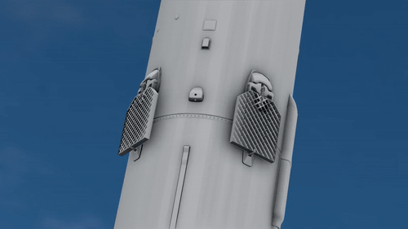
Controls
Work with mechatronics and controls teams
Implement calculations for controls
Use sensor data
Calcs will decide what to do with fins every cycle

Slide 11
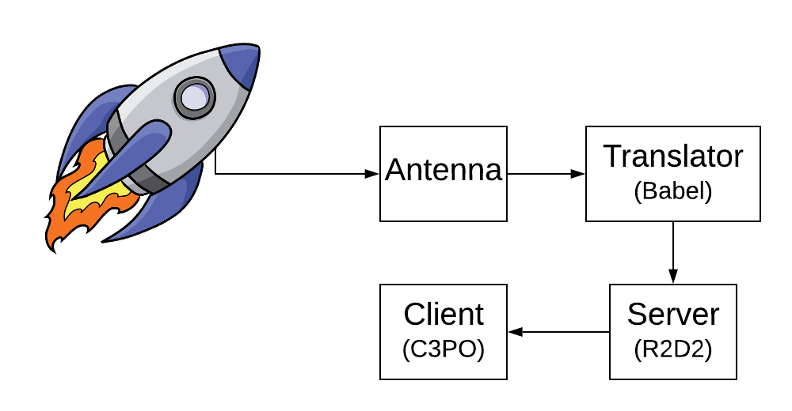
Ground Station
Will receive data packets from rocket.
We will not implement two way communication because there is no need.
Will allow us to log data and graph values for monitoring.

Slide 12
Packet Format
Assuming the following sensor data is transmitted in 4 bytes each:
Timestamp, system health(2bytes), altitude, GPS x-axis, GPS y-axis, GPS z-axis,
acceleration x-axis, y-axis, z-axis,
gyroscope x-axis, y-axis, z-axis,
PT 1, PT 2, PT 3, PT 4, PT 5, PT 6,
TC 1, TC 2, TC 3, TC 4, TC 5, TC 6, TC 7, TC 8
We would just be transmitting an array of floats or custom data structure.
If the data is collected with a 10Hz (100ms) update rate, there will be 1020 bytes of data for every 1 second interval.

Slide 13
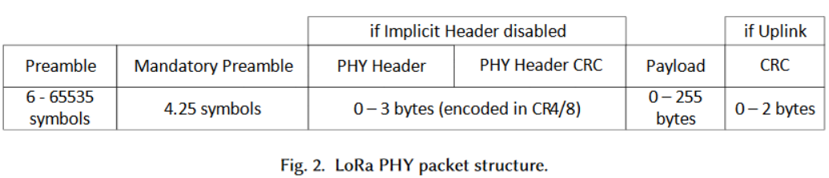
Packet Structure
Each packet can contain up to 255 bytes.
Physical layer handled by the library.
Employing just the LoRaPHY layer

Slide 14
Data Logging
Data Logging will happen on board using SD cards.
Yin will be data logging
Sensor data
Yang will be data logging
Controls calcs
System feedback
Critical Events (Solenoid actuations, seperation, change in state)
Each board will be able to do priority data logging
This is for multi-master implementation
We have learned from Mote so we will use something like: https://github.com/thijse/Arduino-Log.

Slide 15
Timeline
Develop initial architecture for a single master I2C architecture. (1 week)
Test this configuration. (Depends on HIL timeline.)
Work on the multi master I2C architecture. (2 - 3 weeks.)
In parallel:
Test transmission range and rate.
Documentation.
Controls is based on flight dynamics timeline.
Recovery controls is based on subsystem requirements.

Slide 16
Next Steps:
Talk with all subsystem leads with each individual subsystem requirements with sensor requirements.
Controls has to complete the equations allowing us to implement for pursuit and test equations.
Recovery needs to finalize deployment method for software support.

Slide 17
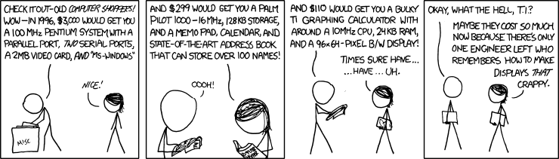
Software Testing
HIL Testing (Be patient)

Slide 18
HIL

Slide 19
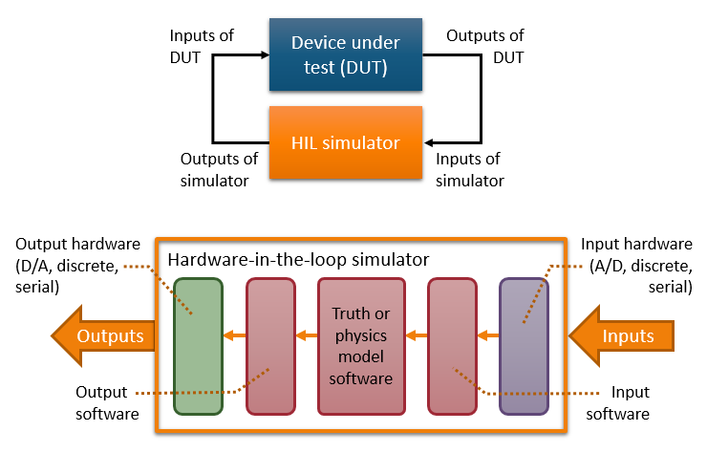
What is Hardware in the Loop (HIL) testing?
See if avionics would work in flight without actually flying a rocket
Replace actual sensor input on rocket with emulated data
Monitor hardware response to emulated data
Sources: https://www.winemantech.com/blog/what-is-hardware-in-the-loop-hil-testing

Slide 20
Goals of HIL
Test Pursuit software and hardware
I2C bus emulation
UART bus emulation
Analog signal emulation (If ADCs don’t work)
PWM monitoring (same)
See if avionics works under different conditions how it responds to unexpected scenarios
Be able to use system to test boards in the future
Be inexpensive to maintain for future devices under test (DUT)
Easy to plug into DUT for testing

Slide 21
Overall System Options
Single microcontroller
Single Slave I2C very easy, multi-Slave requires a lot of work
SPI is only 1-way
Some other protocols are not easily monitored
FPGA
Could emulate every bus
Development would be hard and slow
Adding flight profiles could be challenging
Multi-microcontroller setup
Resolves I2C Slave addressing issues
Still only 1-way SPI
Increased system complexity
Discovery Board
Not parallelizable

Slide 22
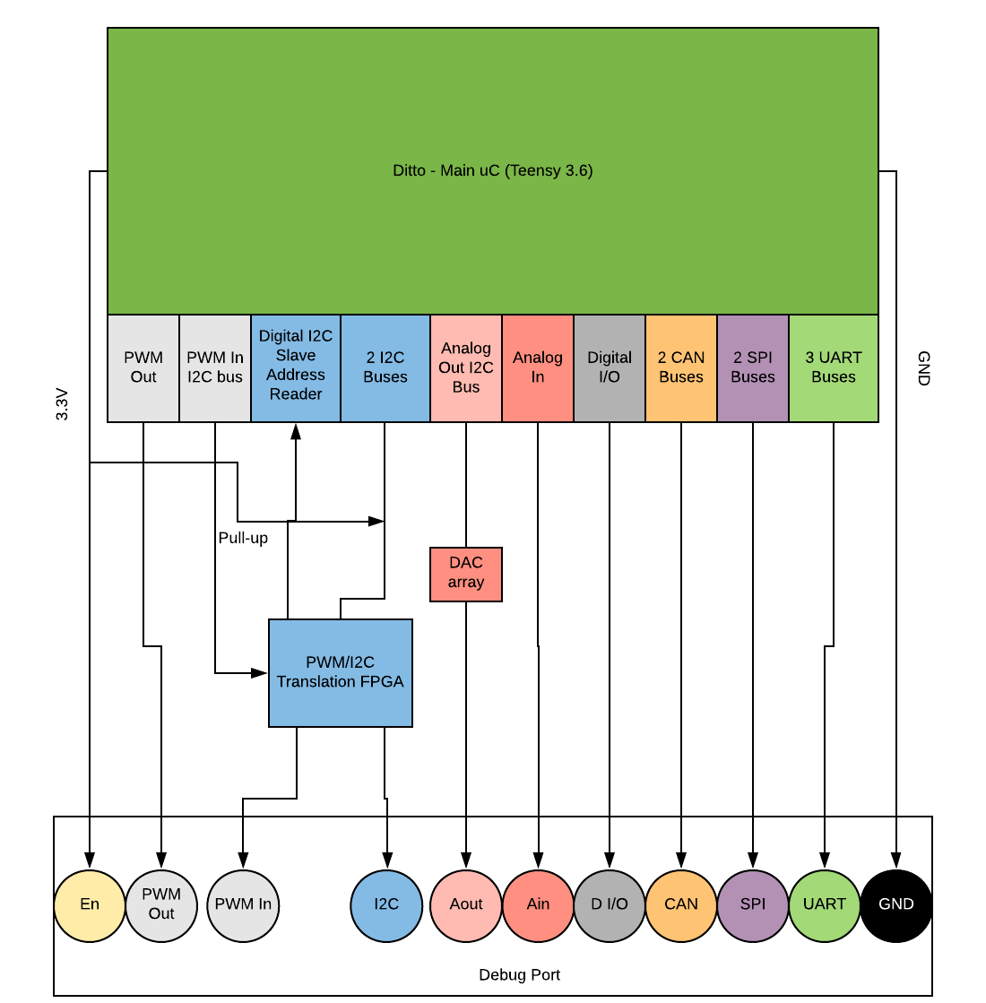

Hardware Schematic
Main uC could either be connected to another monitor PC to load flight profiles or from SD card
Debug port is generic and covers as many protocols as possible so it could be reused
Circuitry/logic to interrupt things like I2C bus on DUT should be built on there
FPGA will translate I2C Slave addresses from DUT to Ditto's Slave address and will send the real address over digital
FPGA can translate PWM from DUT to I2C Ditto can read. Ditto just outputs PWM normally
Debug port connector is very large on Ditto but could have smaller pin-mapping adapters for individual DUTs

Slide 23
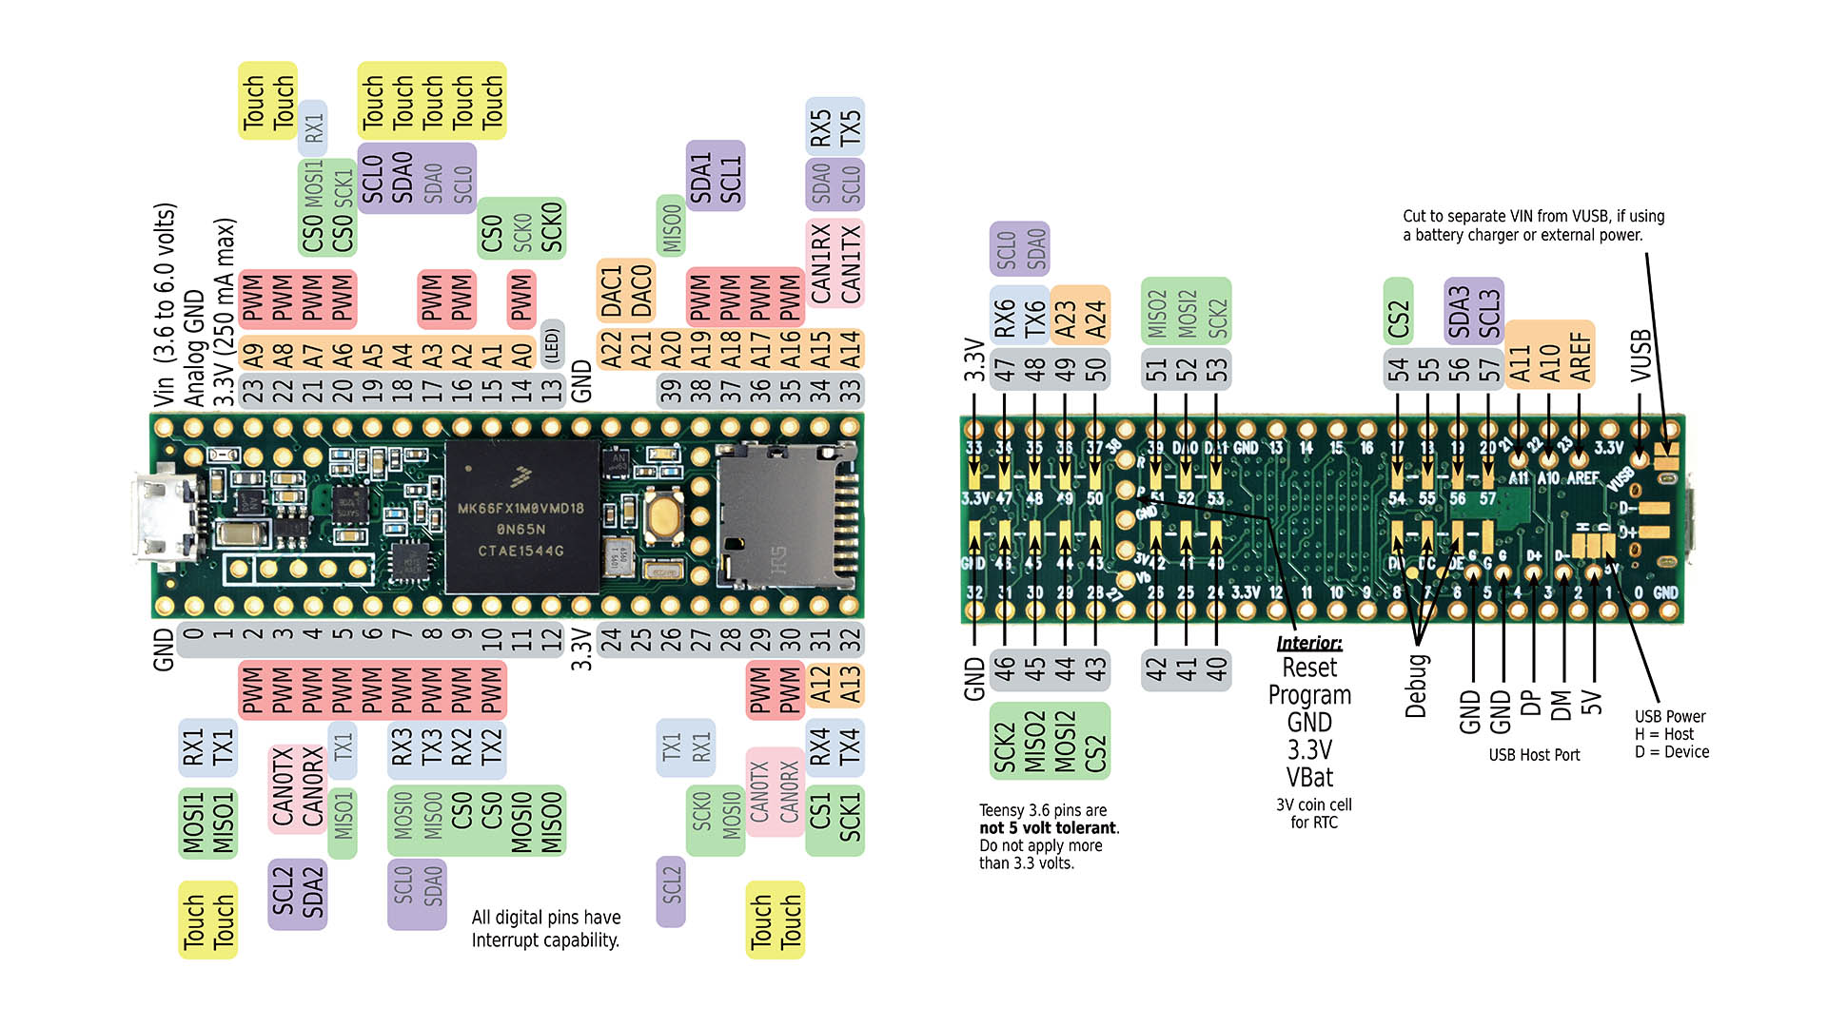
Components - Microcontroller
Teensy 3.6
Tons of GPIO
4 I2C buses
3 SPI buses
6 Serial Ports
Lots of Ain
Two onboard DACs
Built-in SD card
Support for TSPISlave library and other Teensy libraries
Source: https://www.pjrc.com/store/teensy36.html

Slide 24
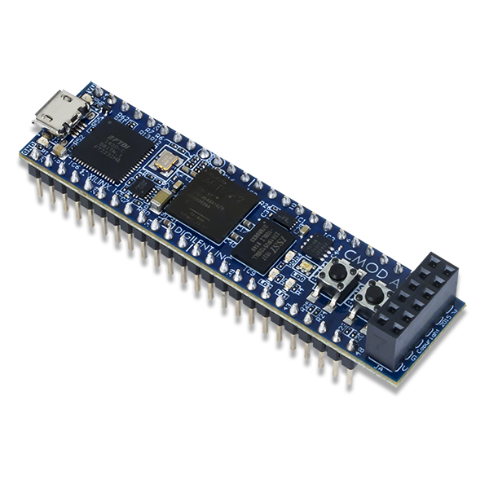
Components - FPGA
Piece of hardware you can change via software
Allows us to build modules for very specific functions (Slave address translating)
Already own copies of it
Has plenty of GPIO
Breadboardable
Can move to a cheaper one later
Source: https://store.digilentinc.com/cmod-a7-breadboardable-artix-7-fpga-module/

Slide 25
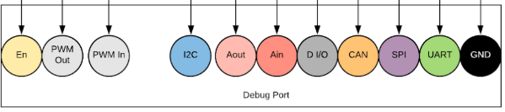
Debug Port
As generic as possible on Ditto side to reuse for other devices
Port on DUT can be much smaller and have adapter made to connect
Enable signal makes changes on DUT (sends signals to switch connections) to allow HIL to happen
Preferable to running individual wires to every signal on DUT

Slide 26
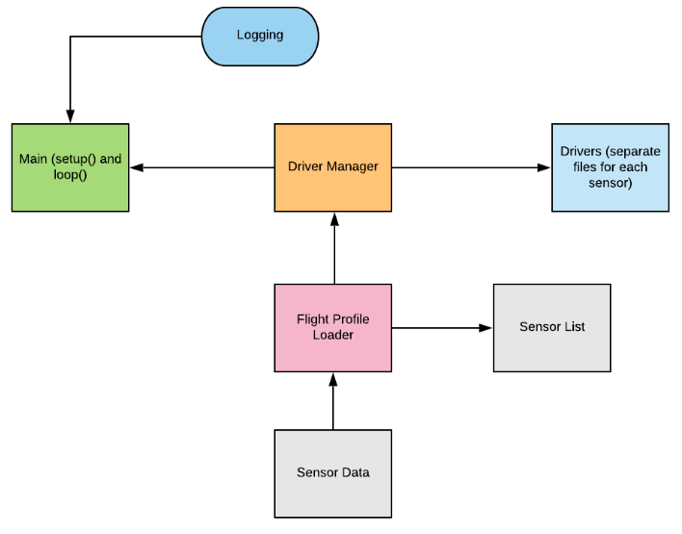
Software Architecture

Slide 27
Capabilities
For Pursuit:
Hijack I2C buses
Hijack UART
Possibly monitor SPI
Potentially read Analog
For future projects:
Hijack SPI buses
CAN buses
PWM i/o
Analog out

Slide 28

Planned Tests
Typical flights - exactly what flight dynamics expects from flight
Low noise
High noise
Some turbulence
Small turbulence
Possible flights - could realistically happen, but still needs to work here
Rocket is way off axis
Pass through inclement weather
Electrical failure (lose a uC or power)
Drogue chute did not deploy (still going too fast)
FUBAR flights - something went very wrong, but what will the rocket do?
Rocket is upside down
Cosmic radiation causes a bit flip or other extreme interference
System-wide failure for extended period of time
Sensors report ridiculous values/are broken
Source:
Star Wars Episode III: Revenge of the Sith

Slide 29
Cost Analysis
Cost per HIL tester unit:
Teensy 3.6 - $29.25
Cmod A7 - $75.00 (cheaper FPGAs available but don’t have currently)
DAC - $6.41
Debug Port headers - ~$1.00
PCB - $4.00 (JLC PCB)
Total: ~$65 - $120

Slide 30
Timeline
Critical Tasks (what we need to test Pursuit ASAP)
Finish I2C translation FPGA and testbench it (1 week)
Write driver manager on Ditto (1-2 weeks)
Write drivers for critical I2C sensors on Pursuit (1 week each)
Implement UART on Ditto (2-3 weeks)
Make an example flight profile file and loader (2-3 weeks)
Support for future tests/projects
Write drivers for sensors (1 week each)
Make flight profiles (1 week)
Make adapter for new DUT (1 week)

Slide 31
Next Steps (HIL)
Software needs to choose drivers and functions for Ditto to spoof
Write drivers for specific sensors we are using on Pursuit
Write driver manager
Finish I2C translation module
Prototype hardware
Create debug port physical design
Make example flight profiles
Develop additional bus support

Slide 32
Questions?

